Slide 1

Infinite focus
Ben Desollar - Adnane Ezouhri – Joslin Some

Slide 2
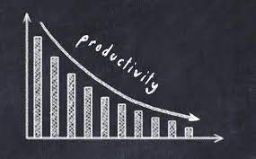



Motivation
Notes:
Out of 1,100, 16.5% of people consume news in a severely problematic way
Puts you in a constant state of high alert preventing your brain from resting for longs periods of time
When asking our peers who we believe are most affected by doom-scrolling, the common factor we found to a majority of them was getting lost on their feed late at night.
Inducing a feeling of tiredness throughout the next day causing a lose in their overall daily productivity.

Slide 3

Solution
Web extension that redirects users to complete tasks when procrastination is detected
Mobile and website component that will allow users to complete their tasks and unblock browser.
Ability to set desired types of goals to complete
Rewards system that will allow users to trade points for extra time in the future

Slide 4
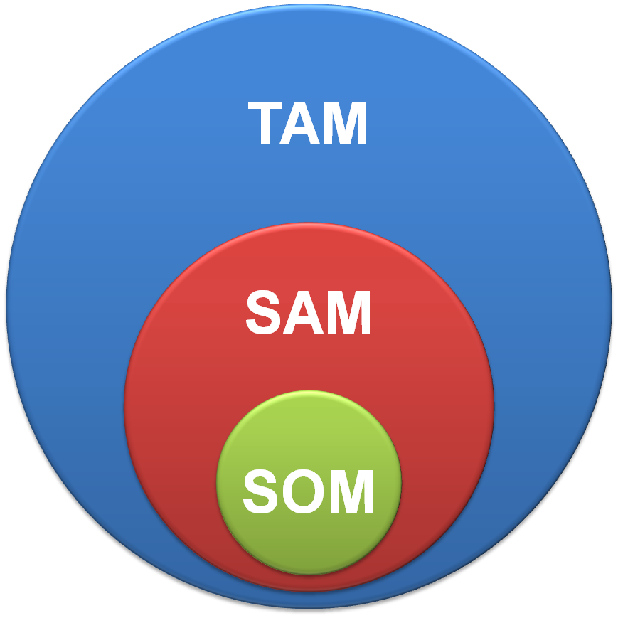
Market potential
Total Addressable market (TAM):
all internet users globally
Serviceable Available Market (SAM):
Internet users struggling with distractions and productivity
Serviceable Obtainable Market (SOM)
Gen Z (students and early professionals) that went through the internet and smartphone boom

Slide 5
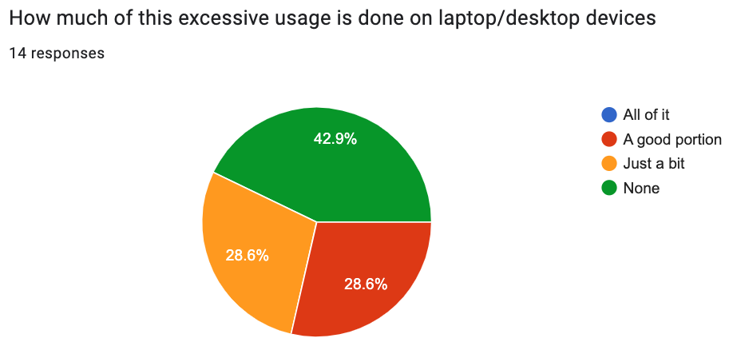
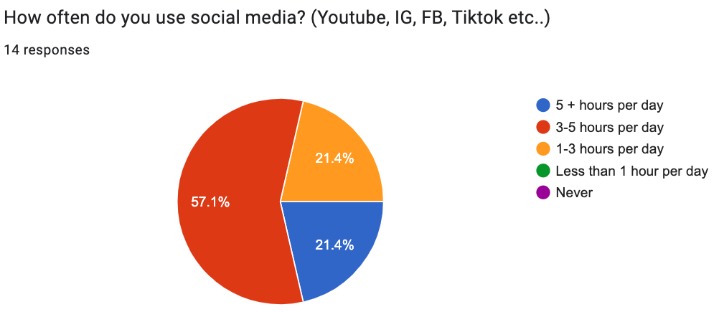
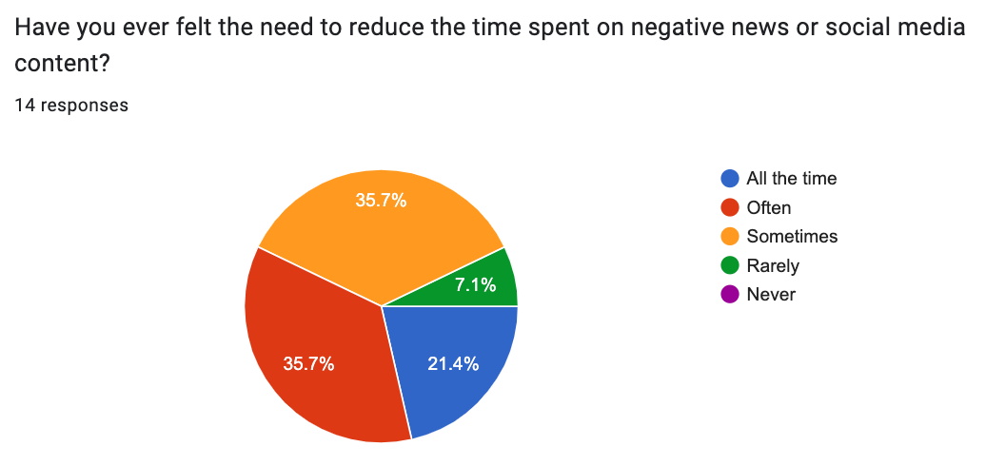
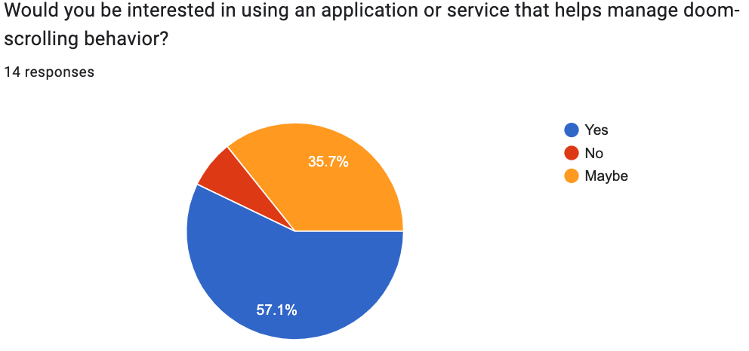
Customer discovery

Slide 6




MERN TechStack

Slide 7
Development process and workflow
Test driven development
Jest
React testing library
Github
Projects
Issues
CI
Wiki

Slide 8
Thank you for your attention!

